Slide 1
Shell Scripting
Linux

Slide 2
Introduction to Shell Scripting
Shell scripting is the process of writing and executing scripts using a command-line shell interpreter.
Automates tasks and sequences of commands to improve efficiency.
Used in various operating systems like Linux, Unix, macOS.

Slide 3
Shell Scripting Basics
A script is a series of commands stored in a file for execution.
Common shell interpreters include Bash, sh, zsh, etc.
Scripts are text files with executable permissions.

Slide 4
Types of Shells
Bash (Bourne Again Shell): Default on most Linux distributions, offers advanced scripting features.
sh (Bourne Shell): Basic and simple shell, precursor to many modern shells.
zsh (Z Shell): Offers extended features like better auto-completion and customization.
csh (C Shell): C-like syntax, with interactive features.

Slide 5
Starting a Shell
Open a terminal or command prompt to start a shell session.
Type the shell's name (e.g., bash, sh) and press Enter.
Shell prompt ($ or #) indicates you're in a shell session.

Slide 6
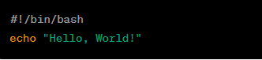
Create Your First Script - Hello World
Open a Text Editor: Use a text editor like nano, vim, or graphical editors.
Write the Script:
Save the Script: e.g., ‘hello.sh’
Make it Executable: Run ‘chmod +x hello.sh’ to give execute permissions.
Run the Script: Execute with ‘./hello.sh’

Slide 7
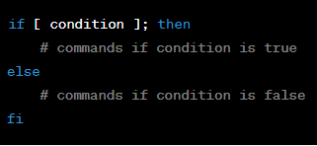
Conditions/If-Else Statements
Use conditionals to make decisions in scripts.
Syntax:

Slide 8
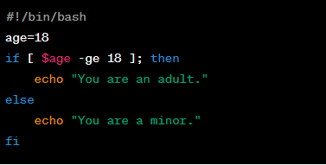
Example:

Slide 9
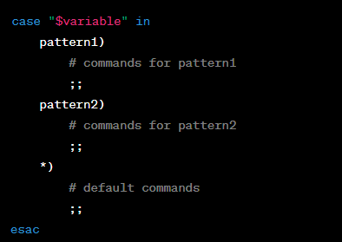
Case Statements
Case statements simplify multi-choice scenarios.
Syntax:

Slide 10
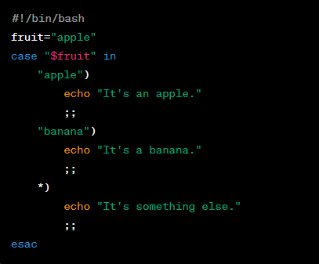
Example:

Slide 11
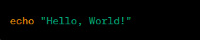
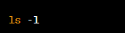

Examples of Common Commands
echo: Display text or variables.
ls: List files and directories.
mkdir: Create a directory.

Slide 12
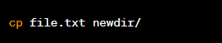
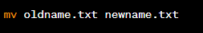
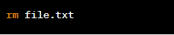
4. cp: Copy files or directories.
5. mv: Move or rename files.
6. rm: Remove files or directories.

Slide 13
Conclusion
Shell scripting automates tasks using scripts.
Basic syntax includes conditionals and case statements.
Different shell types offer varying features.
Examples demonstrate creating scripts and using common commands.

Slide 14
Save the Script: e.g., hello.sh
Make it Executable: Run chmod +x hello.sh to give execute permissions.
Run the Script: Execute with ./hello.sh.

